Slide 1
GUI Using Python

Slide 2
Recommended Version: 2.7 or latest
Source :
http://www.tutorialspoint.com/python/python_gui_programming.htm

Slide 3
Tkinter: Tkinter is the Python interface to the Tk GUI toolkit shipped with Python. We would look this option in this chapter.
wxPython: This is an open-source Python interface for wxWindows
JPython: JPython is a Python port for Java which gives Python scripts seamless access to Java class libraries on the local machine

Slide 4
Tkinter Programming
Tkinter is the standard GUI library for Python. Python when combined with Tkinter provides a fast and easy way to create GUI applications. Tkinter provides a powerful object-oriented interface to the Tk GUI toolkit.
Creating a GUI application using Tkinter is an easy task. All you need to do is perform the following steps −
  Import the Tkinter module.
  Create the GUI application main window.
  Add one or more of the above-mentioned widgets to the GUI application.
  Enter the main event loop to take action against each event triggered by the user.

Slide 5
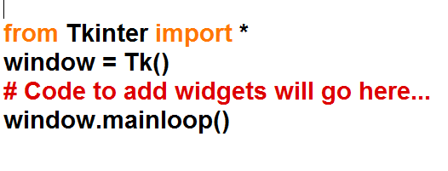
Program1

Slide 6
Tkinter Widgets
Tkinter provides various controls, such as buttons, labels and text boxes used in a GUI application. These controls are commonly called widgets.
There are currently 15 types of widgets in Tkinter. We present these widgets as well as a brief description in the following table −

Slide 7
Operator | Description
Button | The Button widget is used to display buttons in your application.
Canvas | The Canvas widget is used to draw shapes, such as lines, ovals, polygons and rectangles, in your application.
Checkbutton | The Checkbutton widget is used to display a number of options as checkboxes. The user can select multiple options at a time.
Entry | The Entry widget is used to display a single-line text field for accepting values from a user.
Frame | The Frame widget is used as a container widget to organize other widgets.
Label | The Label widget is used to provide a single-line caption for other widgets. It can also contain images.
Listbox | The Listbox widget is used to provide a list of options to a user.
Menubutton | The Menubutton widget is used to display menus in your application.
Menu | The Menu widget is used to provide various commands to a user. These commands are contained inside Menubutton.
Message | The Message widget is used to display multiline text fields for accepting values from a user.
Radiobutton | The Radiobutton widget is used to display a number of options as radio buttons. The user can select only one option at a time.
Scale | The Scale widget is used to provide a slider widget.
Scrollbar | The Scrollbar widget is used to add scrolling capability to various widgets, such as list boxes.
Text | The Text widget is used to display text in multiple lines.
Toplevel | The Toplevel widget is used to provide a separate window container.
Spinbox | The Spinbox widget is a variant of the standard Tkinter Entry widget, which can be used to select from a fixed number of values.
PanedWindow | A PanedWindow is a container widget that may contain any number of panes, arranged horizontally or vertically.
LabelFrame | A labelframe is a simple container widget. Its primary purpose is to act as a spacer or container for complex window layouts.
tkMessageBox | This module is used to display message boxes in your applications.

Slide 8
Standard attributes
Let us take a look at how some of their common attributes.such as sizes, colors and fonts are specified.
  Dimensions
  Colors
  Fonts
  Anchors
  Relief styles
  Bitmaps
  Cursors

Slide 9
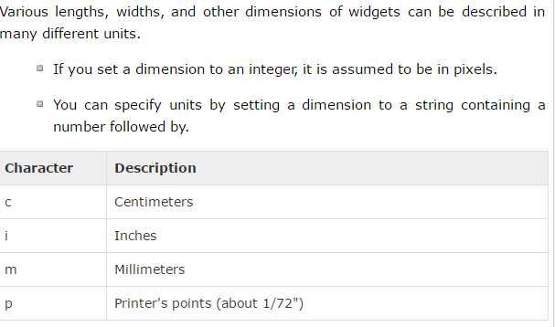
Dimensions

Slide 10
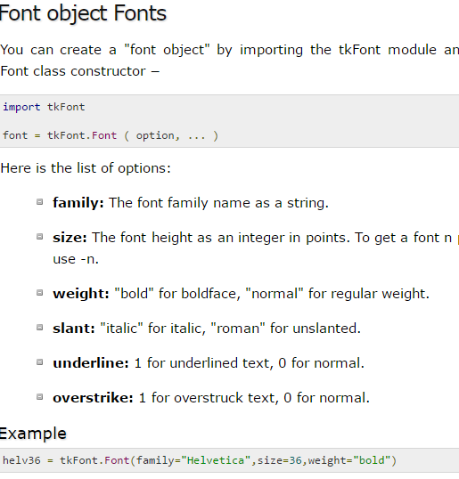
Fonts

Slide 11
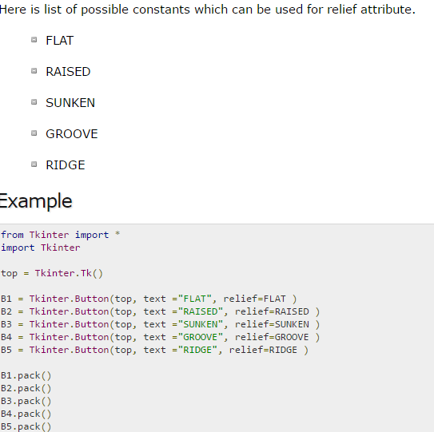
Relief Styles

Slide 12
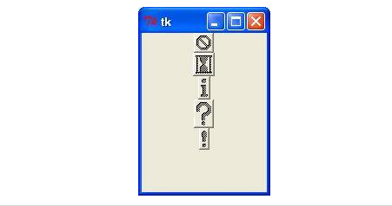
BIT MAPS

Slide 13
Geometry Management
All Tkinter widgets have access to specific geometry management methods, which have the purpose of organizing widgets throughout the parent widget area. Tkinter exposes the following geometry manager classes: pack, grid, and place.
  The pack() Method - This geometry manager organizes widgets in blocks before placing them in the parent widget.
  The grid() Method - This geometry manager organizes widgets in a table-like structure in the parent widget.
  The place() Method -This geometry manager organizes widgets by placing them in a specific position in the parent widget.

Slide 14
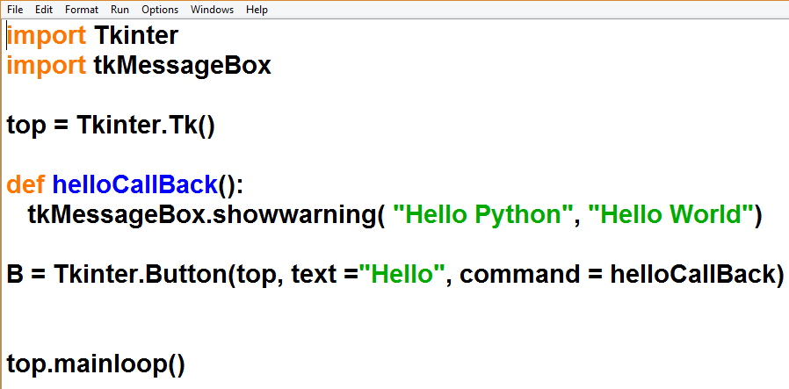
Button
Program2

Slide 15
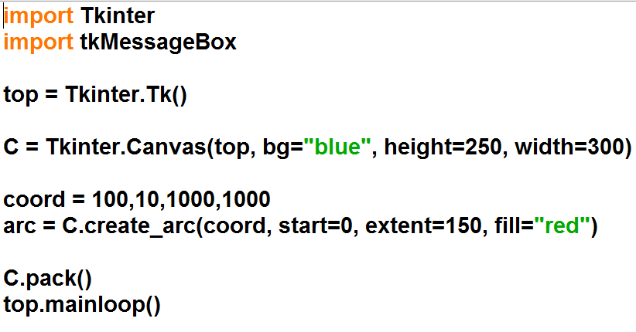
Canvas
The Canvas is a rectangular area intended for drawing pictures or other complex layouts. You can place graphics, text, widgets or frames on a Canvas.
program3

Slide 16
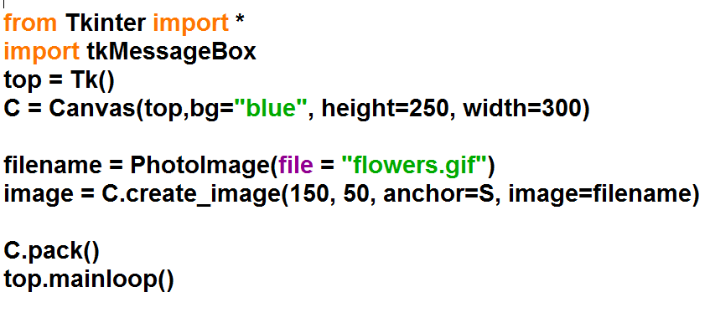

Slide 17
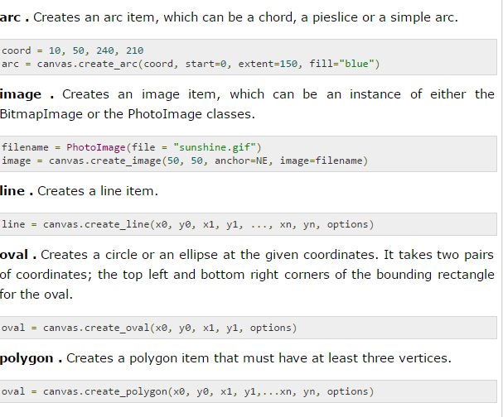

Slide 18
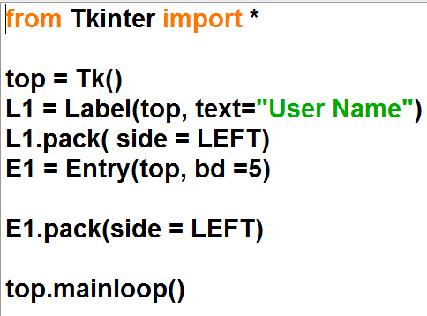
Entry
program4

Slide 19
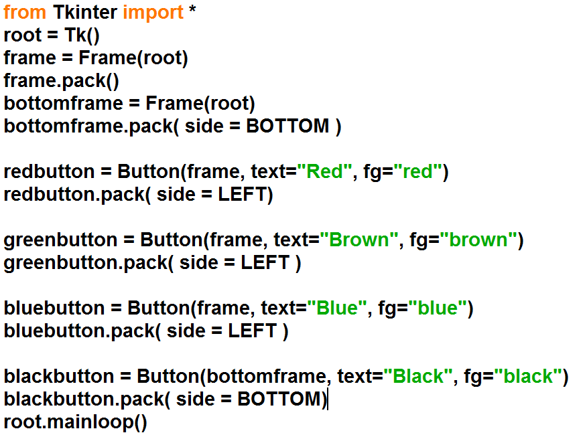
Frame
program5

Slide 20
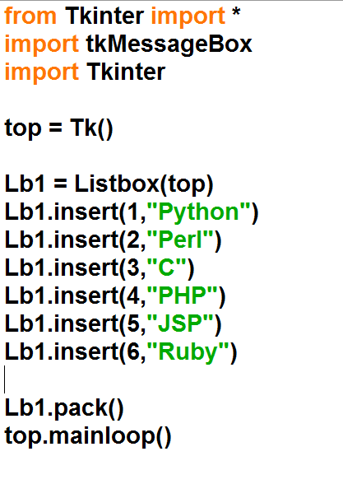
Listbox
Program6

Slide 21
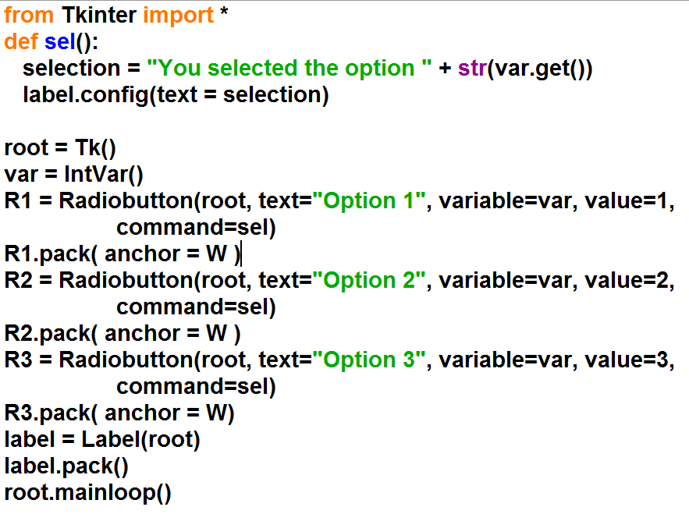
Radiobutton
program7

Slide 22
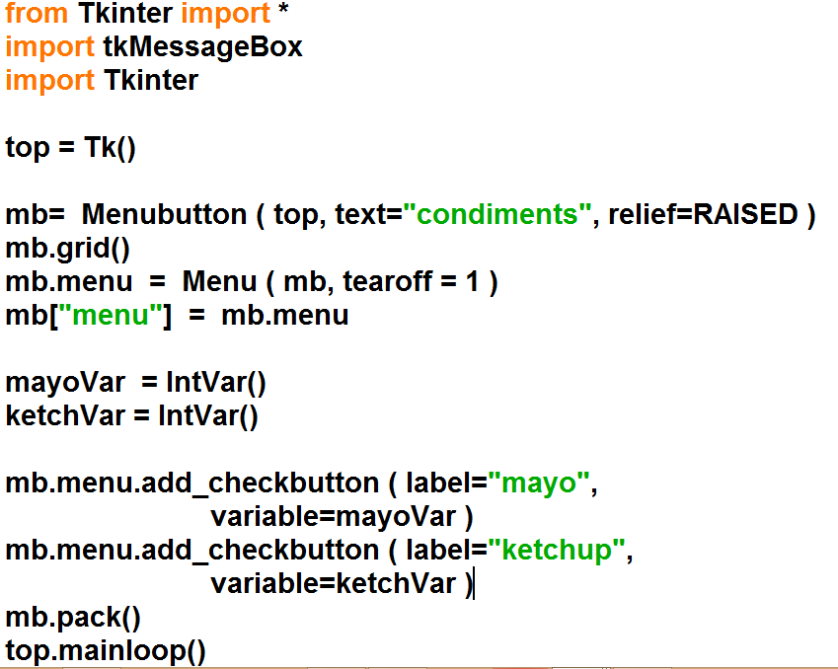
Menubutton
program8

Slide 23
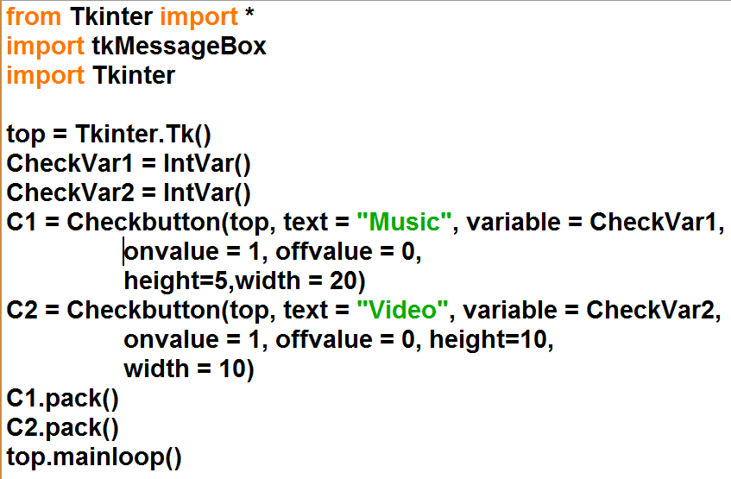
Check button
program9

Slide 24
Bring Image
# Putting a gif image on a canvas with Tkinter
from Tkinter import *
root=Tk()
# create the canvas, size in pixels
canvas = Canvas(width = 300, height = 200, bg = 'yellow')
# pack the canvas into a frame/form
canvas.pack(expand = YES, fill = BOTH)
# load the .gif image file
# put in your own gif file here, may need to add full path
gif1 = PhotoImage(file = 'dw.gif')
# put gif image on canvas
# pic's upper left corner (NW) on the canvas is at x=50 y=10
canvas.create_image(50, 10, image = gif1, anchor = NW)
# run it ...
root.mainloop()
Program

Slide 25
